Slide 1
School Bus Transportation Supervisors of New Jersey
December 6th, 2019

Slide 2
1
4
THE CLEARINGHOUSE FINAL RULE
FREQUENTLY ASKED QUESTIONS
About the Congressional mandate and what it means for you
Specific questions and answers FMCSA received recently about the Clearinghouse
2
5
TIMELINE
REGISTER FOR THE CLEARINGHOUSE
Project milestones leading up to and beyond implementation
Registration for the Clearinghouse is now open
3
USING THE CLEARINGHOUSE
6
FOR MORE INFORMATION
Required actions users must take once the Clearinghouse is operational
Additional resources and information, as well as points of contact

Slide 3
The Clearinghouse Final Rule
Mandated by Congress (MAP-21, Section 32402)
Published December 5, 2016
Established requirements for the Clearinghouse
Identified January 6, 2020 as the Clearinghouse implementation date
Read the Clearinghouse final rule at:
www.fmcsa.dot.gov/regulations/commercial-drivers-license-drug-and-alcohol-clearinghouse

Slide 4
Timeline: Drug and Alcohol Clearinghouse
March 2019
October 2019
November 2019
January 6, 2020
January 6, 2023
Information Phase
Clearinghouse website launched
Subscribe for email updates
Registration Opens
Create your user account ahead of implementation date
Query Plans Available for Purchase
Purchase your query plan ahead of implementation date
Implementation Date
Mandatory reporting begins
Both electronic and manual queries required
3-Year Post Implementation
Clearinghouse contains 3 years of violation data
Only electronic queries required

Slide 5
Who will be required to use the Clearinghouse?
Drivers who hold commercial driver’s licenses (CDLs) or commercial learner’s
permits (CLPs)
Employers of CDL drivers who operate commercial motor vehicles (CMVs)
Consortia/Third-Party Administrations (C/TPAs)
Medical Review Officers (MROs)
Substance Abuse Professionals (SAPs)
State Drivers Licensing Agencies (SDLAs)

Slide 6
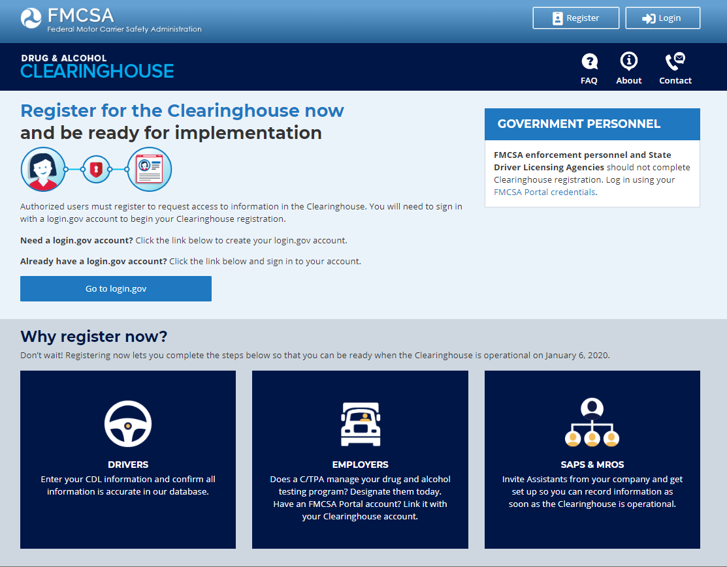
Registration
Create a Login.gov Account
Accessing the Clearinghouse requires the creation of an account with login.gov, a shared service that offers secure online access to participating government systems.

Slide 7
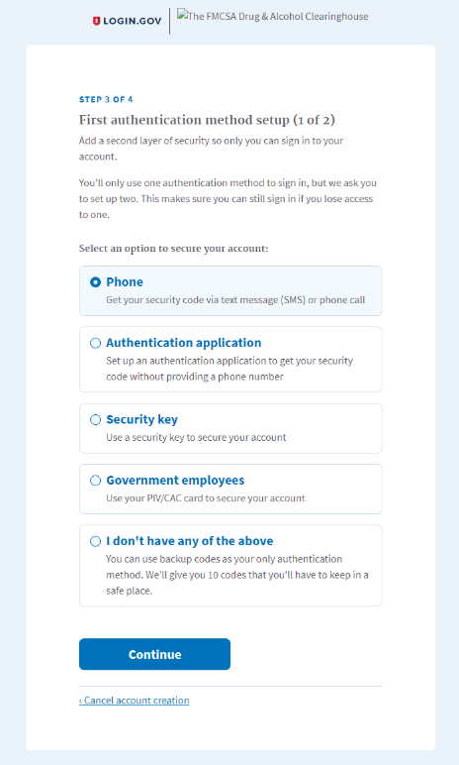
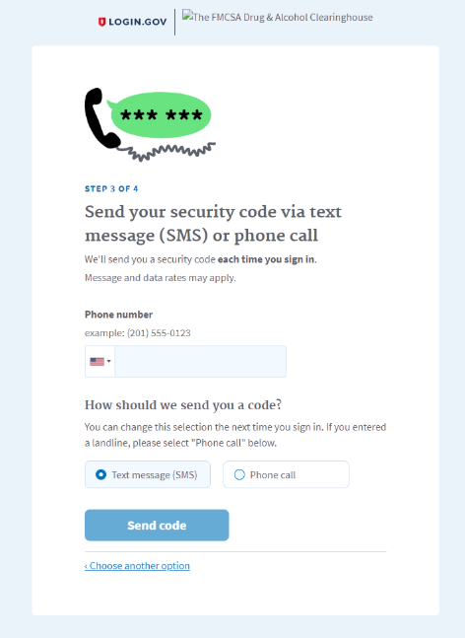
Registration
Login.gov requires the completion of a user verification process
Authentication via phone (voice or text message), authentication application, or security key

Slide 8
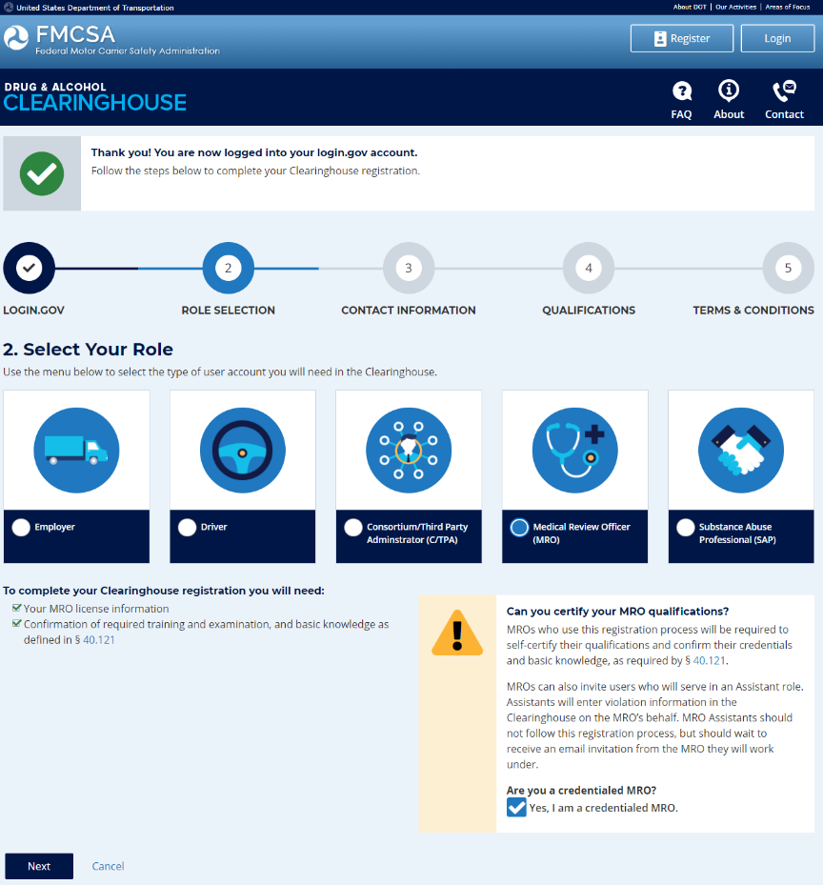
After setting up a login.gov account, registration will be completed in the Clearinghouse.
Employers will be asked about their Portal credentials
Owner/Operators will be asked to identify their C/TPA.
Drivers will enter their CDL information
MROs and SAPs will need to certify they meet the Part 40 requirements

Slide 9
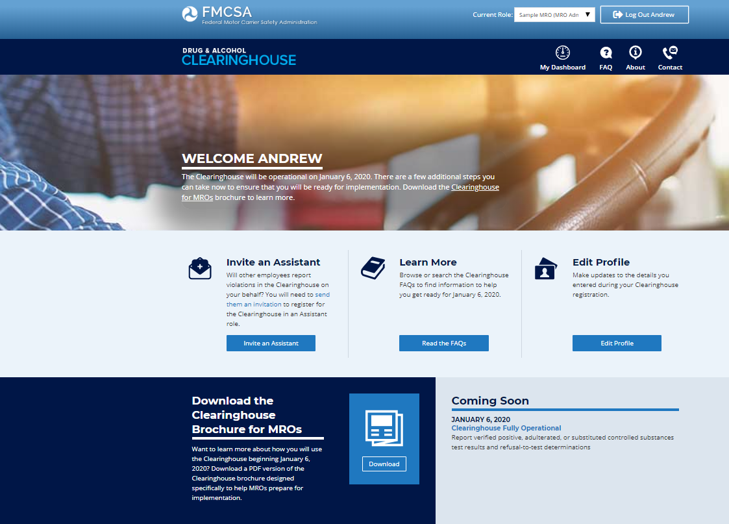
User Dashboard
Homepage for role based Clearinghouse activity including
Invite and manage assistants
Manage C/TPAs
Purchase query plans (November)
Report drug and alcohol program violations (January)
Conduct queries (January)

Slide 10
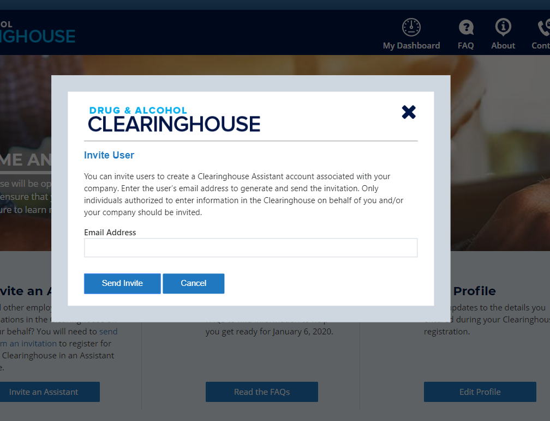
Clearinghouse Assistants
All Assistants must be invited to register in the Clearinghouse
C/TPA Assistant enters violation information and queries the Clearinghouse on behalf of the authorized C/TPA; may support multiple C/TPAs
MRO Assistant enters violation information into the Clearinghouse on behalf of the authorized MRO; may support multiple MROs
SAP Assistant enters RTD information into the Clearinghouse on behalf of the authorized SAP; may support multiple SAPs

Slide 11
Drivers
Drivers will complete the following actions in the Clearinghouse:
REGISTER
VIEW their information
PROVIDE or refuse specific electronic consent to an employer for a full query (includes pre-employment queries)
IDENTIFY a SAP before the SAP can enter return-to-duty (RTD) information about them
Drivers may:
Submit a petition to correct inaccurately reported information as established in the Clearinghouse final rule and per 49 CFR Part 10
Request the removal from the Clearinghouse of an employer’s report of actual knowledge of a driver’s traffic citation for operating a CMV under the influence of drugs or alcohol if the citation did not result in a conviction
Request that other reports of actual knowledge violations, as well as “failure to appear” test refusals, be removed from the Clearinghouse if they were not reported in accordance with §382.705(b)(5)

Slide 12
Driver – Petition Process
How does a driver change or remove inaccurate data?
The driver may submit a petition via FMCSA’s DataQs system
FMCSA will review petition and notify driver of decision to remove, retain, or correct information in the Clearinghouse and the reason for decision
If the driver believes a petition decision was made in error, he/she may submit a request for an Administrative Review
Request must include an explanation why he/she believes FMCSA made an error in their decision
Driver informed of decision
Decision will constitute as the final Agency action
The petition must include:
Petitioner’s contact information
Petitioner’s CDL number and state of issuance
Detailed description why the information is not accurate
What information may be challenged by the driver?
The accuracy of the information reported
Report of employer’s actual knowledge the driver received a traffic citation for driving a CMV while under the influence of drugs or alcohol if it did not result in a conviction
Accuracy of test results and refusals may not be challenged
Will an employer be notified if information is changed or removed from the Clearinghouse as a result of a petition?
Yes, the employer will receive a notification whenever information in a queried driver’s Clearinghouse record has been changed or removed.

Slide 13
Employers and Consortia/Third-Party Administrators (C/TPAs)
Users will complete the following actions in the Clearinghouse:
Register in the Clearinghouse
Report certain drug and alcohol violations in the Clearinghouse
Request specific consent in the Clearinghouse from the driver they wish to conduct a full query on (includes pre-employment queries)
Report a negative return-to-duty alcohol and/or controlled substances test result
Report the completion of a driver’s follow-up testing plan
Designate assistants in the Clearinghouse before the assistant can enter violation information or conduct queries on their behalf
An EMPLOYER who employs him/herself as a driver (owner-operator) must designate a C/TPA in the Clearinghouse.
The C/TPA must be designated by the employer in the Clearinghouse before the C/TPA can report violation information or query the Clearinghouse on behalf of the employer.

Slide 14
Queries
Query Type | Reason for Query | Information Returned | Required Action
LIMITED QUERY | Annual check on currently-employed driver | No records found in the Clearinghouse for queried driver | No action required
 | Ad hoc/periodic check on driver | Records found in the Clearinghouse for queried driver | Full query must be conducted for violation and/or RTD details to be released; if full query is not conducted within 24 hours, driver is removed from safety-sensitive functions, including operating a CMV
FULL QUERY | Pre-employment check on prospective driver Limited query returned records found for queried driver Ad hoc/periodic check on driver | Full violation and/or RTD details for queried driver | If driver has a violation and no negative RTD test result, driver is removed from safety-sensitive functions If driver has a violation and a negative RTD test result, no action required

Slide 15
Consent Requests
Query Type | When is driver consent required? | How is consent provided? | For how long is consent effective? | What action is required?
LIMITED QUERY | Annual check on currently-employed driver Ad hoc/periodic check on driver | Outside the Clearinghouse May be electronic or wet signature Note: FMCSA has provided a sample limited consent request form on the website | Limited consent form must specify time range | Consent refused Query cannot be conducted Driver removed from safety-sensitive functions Consent provided Retain via paper or electronically in driver’s qualification file Request limited query in the Clearinghouse
FULL QUERY | Pre-employment check on prospective driver Limited query returned information exists for queried driver Ad hoc/ periodic check on driver | Electronically within the Clearinghouse | For each full query for individual driver | Consent refused Employer notified of refused consent Query cannot be conducted Driver cannot perform/removed from safety-sensitive functions Consent provided Query conducted Violation details released, including RTD status If queried driver has violation and no negative RTD test result, driver removed from safety-sensitive functions

Slide 16
Reporting to the Clearinghouse
What information is the employer or designated C/TPA required to report?
REPORTING ENTITY | INFORMATION TO BE REPORTED TO CLEARINGHOUSE | DEADLINE FOR REPORTING INFORMATION
Prospective/Current Employer of CDL Driver Or Service agent acting on behalf of Current Employer of CDL Driver | An alcohol confirmation test with a concentration of 0.04% or higher. | By the close of the 3rd business day
 | Refusal to test (alcohol) as specified in 49 CFR 40.261.
 | Refusal to test (drug) not requiring a determination by the MRO as specified in 49 CFR 40.191.
 | Actual knowledge, as defined in 49 CFR 382.107, that a driver has used alcohol on duty, used alcohol within four hours of coming on duty, used alcohol prior to post-accident testing, or has used a controlled substance.
 | Negative RTD test results (drug and alcohol testing, as applicable)
 | Completion of follow-up testing.

Slide 17
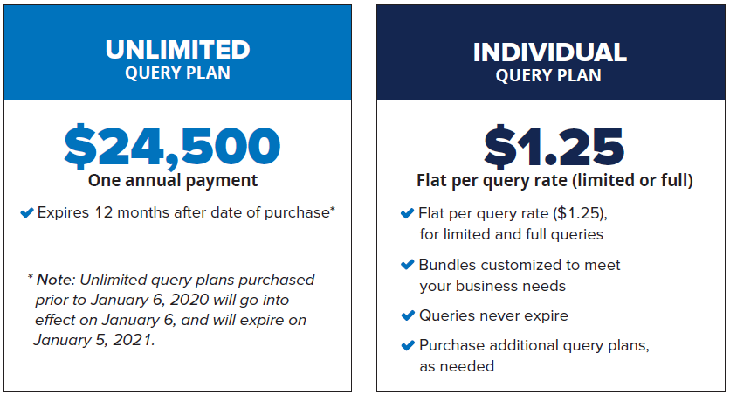
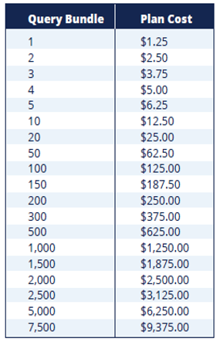
Frequently Asked Questions
Recommended for High-volume users

Slide 18
Frequently Asked Questions
Why purchase a query plan?
Employers are charged a fee for conducting queries in the Clearinghouse.
Employer must purchase a query plan to ensure they or their designated C/TPAs can conduct queries.
Can C/TPAs purchase a query plan?
No, only employers can purchase query plans.
How does the employer purchase a query plan?
Query plans may only be purchased from FMCSA on the Clearinghouse website.
Which query plan is right for me?
Query bundles
Purchase the number of queries equal to the number of your current employees (satisfy your annual queries needs)
Purchase additional query plans, as needed
Unlimited query subscription
High volume users
When will query plans be available for purchase?
Query plans will be available in November 2019

Slide 19
Medical Review Officers (MROs) and Substance Abuse Professionals (SAPs)
MROs:
WORK for MRO company(ies), or self-employed
REGISTER for the Clearinghouse and complete the verification process
ENTER drug violation information to the Clearinghouse
DESIGNATE MRO Assistant(s) to enter violation information on their behalf
SAPs:
WORK for SAP company(ies), or self-employed
REGISTER for the Clearinghouse and complete the verification process
ENTER RTD information into the Clearinghouse (date initial assessment completed, date driver eligible for RTD test)
DESIGNATE SAP Assistant(s) to enter RTD information on their behalf
All Assistants must be invited to register in the Clearinghouse.
Driver must identify the SAP in the Clearinghouse before the SAP may enter RTD information in the Clearinghouse.

Slide 20
Reporting to the Clearinghouse
What information is the MRO or SAP required to report?
 | INFORMATION TO BE REPORTED TO CLEARINGHOUSE | DEADLINE FOR REPORTING INFROMATION
MRO | Verified positive, adulterated, or substituted drug test result | Within two business days of making a determination or verification of a DOT-approved drug test
 | Refusal to test (drug) requiring a determination by the MRO as specified in 49 CFR 40.191
 | Changes a verified drug test per 49 CFR Part 40 | Within one business day of making any change in the reported results
SAP | Identification of driver and date the initial assessment was initiated | By the close of the business day following the date of initial assessment
 | Date of determination of eligibility for RTD testing | By the close of the business day following the determination that the driver completed the RTD process

Slide 21
Frequently Asked Questions
Will violations that occurred prior to January 6, 2020, be reported to the Clearinghouse?
No, only violations that occur on January 6, 2020, or later.
How long is the violation information retained in the Clearinghouse?
5 years, unless the RTD and follow-up testing is not completed (will be retained indefinitely until follow-up testing is successfully completed).
Will a prospective employee’s drug and alcohol violation history with other DOT modes be available in the Clearinghouse?
No, the Clearinghouse will contain only drug and alcohol program violation information for employees subject to the testing requirements under the Federal Motor Carrier Safety Regulations in 49 CFR part 382.

Slide 22
Frequently Asked Questions
Will every driver need to register in the Clearinghouse?
No. A driver will only need to register if they need to provide consent to the employer in the Clearinghouse for pre-employment/full queries.
If a driver is currently with an employer, never incurs a drug or alcohol violation, and never seeks other employment, then the driver does not need to register in the Clearinghouse.
Can an employer register their drivers in the Clearinghouse?
No. Each individual driver will need to register himself or herself. Registration and login will require users to complete the verification process
Are employers of non-CDL drivers who operate CMVs required to query or report violations to the Clearinghouse?
No. Only employers who employ drivers subject to Parts 382 and 383 must query or report information to the Clearinghouse.
Can an employer or MRO enter a drug and alcohol program violation if the driver is not registered for the Clearinghouse?
Yes. The Clearinghouse will associate the violation with a driver’s CDL information. This will be recorded even if the driver has not registered for the Clearinghouse.

Slide 23
Frequently Asked Questions
Will the employer be notified if a new violation is recorded on previously queried driver?
The employer will receive a notification if a new violation was recorded in the Clearinghouse for the queried driver within 30 days of conducting a pre-employment query (30-day look back).
The employer must receive additional electronic consent from the driver before a full query can be conducted to view detailed violation information.
Will the employer receive notification of new violations within 30 days of all completed queries?
The employer will not receive a notification of new violations after completing a limited (including annual) query or ad hoc full query.
The employer will receive a notification if a new violation was recorded in the Clearinghouse for the queried driver within 30 days of conducting a pre-employment query (30-day look back).

Slide 24
Frequently Asked Questions
Are Canadian and Mexican drivers conducting operations in the United States subject to the Clearinghouse requirements?
Yes, only Canadian and Mexican drivers operating in the United States are required to comply with FMCSA drug and alcohol testing requirements and must comply with the Clearinghouse final rule.
Must Canadian and Mexican employers report drug and alcohol program violations to the Clearinghouse?
Yes, only Canadian and Mexican employers operating in the United States are required to comply with FMCSA drug and alcohol testing requirements and must report drug and alcohol violations to the Clearinghouse.

Slide 25
Frequently Asked Questions
Can an employer designate more than one C/TPA?
Yes.
Who will record positive alcohol results for an owner/operator?
The designated C/TPA would be responsible to record this violation information regarding the owner/operator they work with.
An owner/operator may view and query their own information.
An owner/operator will be required to self-identify as an owner/operator and will be required to designate a C/TPA to access their Clearinghouse account.

Slide 26
Frequently Asked Questions
Will a driver’s follow-up testing plan be available in the Clearinghouse?
No, follow-up testing plans will not be uploaded into the Clearinghouse.
When a prospective employee has not completed a follow-up testing plan prescribed by the SAP, the subsequent new employer must continue to obtain the follow-up testing plan from the previous employer, as required in §382.413, and complete the follow-up testing.
Will follow-up testing be tracked within the Clearinghouse?
No, follow-up testing will not be tracked in the Clearinghouse.
However, if there is a positive follow-up test result, it must be reported as a new violation.
The RTD process would be re-initiated after the new violation is entered.

Slide 27
Frequently Asked Questions
Will an API (application programming interface) be available for an employer or C/TPA to query or report violations in the Clearinghouse?
No, at the initial launch an API will not be available. FMCSA will consider this functionality in the future.
However, a bulk query functionality will be available to query the Clearinghouse. (Template to be provided on Clearinghouse website)
If a driver is on the road and unable to access a computer, how can the driver access the Clearinghouse?
The Clearinghouse is mobile-friendly. The driver will be able to access the Clearinghouse from a smart phone, log in and view their information as well as provide consent and identify their substance abuse professional, if applicable.

Slide 28
Frequently Asked Questions
Is the driver’s social security number (SSN) or employee identification number (EIN) required when reporting violation information or querying the Clearinghouse?
No, per §382.123, the employer shall provide the driver’s CDL number and state of issuance
What information is required on the Custody and Control Form (CCF) or Alcohol Testing Form (ATF)?
The driver’s CDL number and state of issuance must be entered in lieu of the driver’s SSN or EIN
Will FAQs and other outreach materials about the Clearinghouse be updated?
Yes, our website at https://clearinghouse.fmcsa.dot.gov will be updated regularly with new information, including the factsheet and FAQs. In addition, you will be able to sign up for email updates.

Slide 29
Register Now
Register your company and/or yourself
Designate C/TPA (employers, if applicable)
Set up Assistants (employers, C/TPAs, SAPs, MROs)
Encourage drivers to register

Slide 30
For more information
Visit https://clearinghouse.fmcsa.dot.gov
Subscribe for email updates
Read frequently asked questions
Download the Clearinghouse factsheet
Download the User Role card
Download User Brochures
Contact clearinghouse@dot.gov

