Slide 1

Law, Ethics and Governance for All Leaders, including an Overview of New and Emerging Issues
School Law Update:
Transportation and Safety Issues
March 30, 2023
Sandra L. Jacques, Esq. LL.M.
LEGAL ONE Supervisor of Legal Research and Content Development

Slide 2
DISCLAIMER
This presentation is intended as a summary of law only and is not meant as legal advice. Please consult your attorney to obtain legal advice.
Participants are authorized to use the LEGAL ONE materials provided in this training to offer turnkey training within the respective participant's school district or place of employment, provided that participants provide proper credit to LEGAL ONE for having developed said materials and further provided that such turnkey training is offered at no charge.

Slide 3
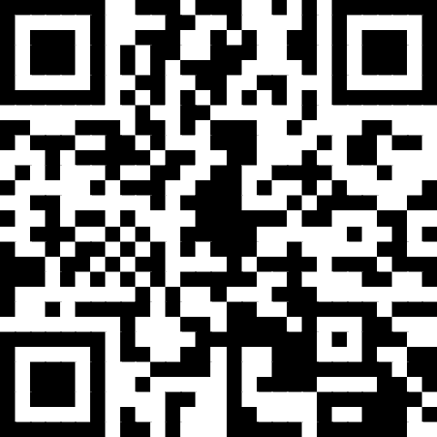
Presentation Materials
Today’s document(s) can be accessed at
https://tinyurl.com/LO-STSNJ-230330
This folder can be accessed for 30 days from the session date.
Please download all files before the link expires.

Slide 4
NJ HIB Law Overview
Legislative Update
Certification Cases
Free Speech Issues
  Legal Standard
  Student Privacy Issues
Reporting Requirements
  Legal Requirement
  HIB
Transgender Student Issues
Scenarios

Slide 5
Legislative update

Slide 6
New Jersey Legislative Update
P.L.2022, c.41 (6/30/2022) – Provides temporary one-year extension of service life of school buses for 2022-2023 school year; authorizes chief administrator of the NJ MVC to allow an additional one-year extension in subsequent two school years upon request of the bus owner.
New Jersey School Boards Association – Serving Local Boards of Education Since 1914

Slide 7
New Jersey Legislative Update
P.L. 2022, c.86 (8/4/2022) – Requires Dept. of Environmental Protection (DEP) to develop and implement a three year electric school bus grant program to determine the operational reliability and cost effectiveness of replacing diesel-powered school buses with electric school buses for the daily transportation of students.
No less than six school districts and bus contractors each year; no less than 18 school districts and bus contractors after the three year period. No more than ½ to bus contractors.
$15 million in first year and $15 million annually in subsequent two years to DEP, subject to availability, to provide grants.
New Jersey School Boards Association – Serving Local Boards of Education Since 1914

Slide 8
New Jersey Legislative Update
P.L.2021, c.306 (11/8/2022) - Revises violation and fines for boards of education or school bus contractors approving or assigning unauthorized individuals as school bus drivers.
Increases the fines from not more than $5,000 for each offense to not more than $5,000 for the first offense, not more than $10,000 for the second offense, and not more than $15,000 for a third and each subsequent offense.
It will not be a defense to avoid liability that a board of education or contractor unknowingly failed to comply with the provisions of law concerning the training, certification, and criminal history record checks of school bus drivers.
New Jersey School Boards Association – Serving Local Boards of Education Since 1914

Slide 9
New Jersey Legislative Update
P.L.2021, c.307 (11/8/2021) Provides for debarment of school bus contractors for certain violations; requires certain information in pupil transportation contract bid. Bid to include name of any person who has any ownership interest. BOE must check debarment list before awarding contract.
NJDOE has the discretion to debar for 1-5 years for: the employment or assignment of an individual as a school bus driver who has been disqualified to serve as a school bus driver or determined ineligible to operate a school bus; failure to comply with the criminal background check requirements; failure to comply with the provisions of the School Bus Enhanced Safety Inspection Act; commission of a criminal offense incident to obtaining or attempting to obtain a public or private contract, or subcontract thereunder, or in the performance of such contract or subcontract; commission of a criminal offense that includes child abuse or sexual misconduct involving a child; a record of failure to perform or of unsatisfactory performance in accordance with the terms of one or more pupil transportation contracts…
P.L. 2021 c. 471 (1/18/2022) - Creates Office of School Bus Safety in Department of Education; appropriates $200,000. Oversee school transportation, collect data, coordinate with MVC, Annual Report to Commissioner
New Jersey School Boards Association – Serving Local Boards of Education Since 1914

Slide 10
School Bus Safety Legislation
Prompted by May 17, 2018 Bus crash in which a 10 year old student and a teacher were killed when a 77 year old bus driver attempted to illegally cross 3 lanes of traffic on 1-80.
Package of legislation signed by Governor Murphy on December 17, 2018:
P.L. 2018, c.151 requires holders of a bus driver license to submit a medical report by a certified medical examiner. It also requires bus drivers over age 70 to submit proof of physical fitness every year, and those over age 75 to submit this proof every six months.
P.L. 2018, c.152 requires that when the Department of Education notifies a board of education or a school bus contractor that a school bus driver has had their bus driver license suspended or revoked, the board of education or school bus contractor must verify to DOE that the driver in question no longer operates a bus for them.
P.L. 2018, c.159 requires school bus operations in the State to comply with federal regulations concerning safety, noise emissions, insurance, and drug testing, among other areas.
P.L. 2018, c.160 requires all permanent and substitute school bus drivers and aides to undergo safety education programs twice every year.
  If 1st training not done already in 2019, should have first training completed as soon as possible.

Slide 11
Bus Driver Safety Education Training
Two times per year, an employer shall administer a safety education program for all permanent and substitute school bus drivers and school bus aides that it employs. At a minimum, the training shall include:
Student management and discipline;
School bus accident and emergency procedures;
Conducting school bus emergency exit drills;
Loading and unloading procedures;
School bus stop loading zone safety;
Inspecting the school vehicle for students left on board at the end of a route; and
The use of a student's education records, including the employee's responsibility to ensure the privacy of the student and the student’s records, if applicable.

Slide 12
Certification cases

Slide 13
Linda Mitchell v. New Jersey Department of Education, Office of Student Protection, 11/29/2021, (#298-21)
FACTS:
Petitioner was a school bus driver employed by the Mt. Laurel BOE
NJDOE suspended her School Bus Endorsement for mandatory 6 months
Allegations
  Failed to visually check her bus for students before leaving the bus unattended while dropping off paperwork at the transportation building
  Petitioner had an “affirmative duty” to visually inspect the bus / check for students
  Undisputed that she failed to check and that a child was left on the bus
    Claims she had not yet “parked the bus”
    Claims 2 staff members were standing near the bus when this occurred
    Student was quickly returned home without incident
HOLDING: SD SJM Granted
NJDOE “to notify the Motor Vehicle Commission of its obligation to suspend Petitioner’s School Bus Endorsement, and to notify Petitioner’s employer that she is ineligible for the period of suspension and continued employment as a school bus driver.”

Slide 14
Ana David-Pedi, New Jersey Department of Education, Office of Student Protection, 11/18/21, (#290-21)
FACTS:
Petitioner was a school bus driver
NJDOE suspended her School Bus Endorsement for mandatory 6 months
Allegations
  Central Jersey Prep student left on her bus at the end of one of her assigned bus routes in February 2021
    Undisputed
  Defenses
    Student was never left alone
    Claims she did a visual “turn around” inspection of the bus instead of a full visual walk-through because she had nowhere to pull over safely before continuing to her next route
    She did the required walk-through after her next stop and found the student asleep in a seat
    She then returned the child safely to Central Jersey Prep
HOLDING: SD SJM Granted
NJDOE “to notify the Motor Vehicle Commission of its obligation to suspend Petitioner’s School Bus Endorsement, and to notify Petitioner’s employer that she is ineligible for the period of suspension and continued employment as a school bus driver.”

Slide 15
Yolette Severe v. New Jersey Department of Education, Office of Student Protection, 10/31/22, (#302-22)
Facts
Petitioner was a school bus driver
A student was left on petitioner’s school bus at the end of one of her assigned bus routes on November 16, 2020.
Petitioner did not dispute that the child was left on the bus but contended that the student was never left alone.
  Although petitioner contended that she had called each student’s name as they left the bus, she conceded that she had not conducted a visual walk-through to check for remaining students, and that after petitioner arrived at the bus parking lot, a student who had fallen asleep awoke and stood up;
  Petitioner then drove the student back to their assigned school.
Holding:
“In accordance with N.J.S.A. 18A:39-29, if a school bus driver is found to have left a pupil on the bus at the end of a route, the driver’s school bus endorsement shall be suspended for six months for the first offense.”

Slide 16
Free speech issues

Slide 17
Students vs. Staff Free Speech Rights
First Amendment protects the right to free speech:
Congress shall make no law…abridging the freedom of speech.
However . . .
  Comparing penalties for students vs. school staff when it comes to “what one can say publicly” is like comparing apples and oranges…
  Students generally have a greater “freedom of expression” than staff members
Pickering Balancing Test vs. Tinker Rule

Slide 18
Staff Speech Issues
“Pickering Balancing Test”
Did the statement concern a matter of general public concern?
Was the employee speaking as a private citizen or during the course of his duties?
Was the statement likely to disrupt a close working relationship?

Slide 19
Pickering Analysis Questions
Does the Speech Interfere with:
  Employee’s daily duties in the classroom?
  Regular operation of the schools generally?
  The working relationship between the speaker and the person or institution at whom the criticism is directed?
Pickering v, Bd. Of Educ. Twp. High Sch. Dist. 205, 391 U.S. 563, 570-572 (1968)

Slide 20
Pickering Analysis Questions
Teacher cannot speak in a manner that:
  Is a reckless disregard for the truth;
  Creates disharmonious relations in the workplace;
  Undermines the immediate supervisor’s discipline over the employee;
  Compromises the loyalty and confidence required of close working employees.
Pickering v, Bd. Of Educ. Twp. High Sch. Dist. 205, 391 U.S. 563, 573 (1968).

Slide 21
Want to Know vs. Need to Know
FERPA – 20 U.S.C. §1232
  Broadly defines “education record”
    SD may provide information that is “educationally relevant” to appropriate parties
Want to know vs. Need to Know
  Unless you have an “educationally relevant” reason to know the information, you are not entitled to receive it
  Curiosity, while understandable, is not an “educationally relevant” reason to receive information

Slide 22
O’Brien v. SOSD of Paterson, Superior Crt, Appellate Division,
Docket No. A-2452-11T4 – December 18, 2012
FACTS:
1st Grade Elementary School Teacher in Paterson
  Class comprised of 6 year old students (all were either Latino or African-American)
Teacher posted 2 comments on Facebook:
  “I’m not a teacher I’m a warden for future criminals!”
  “They had a scared straight program in school why couldn’t [I] bring [first] graders?”
SD became aware of the Facebook posts
Teacher said that she “didn’t intend her comments to be offensive, but she was otherwise unrepentant.”
News of the Facebook postings spread in the community
  2 angry parents went to the SD offices to express their outrage
  One parent threatened to remove their child from the school
  School received at least a dozen irate phone calls
  There was a protest outside of the school (approximately 20-25 people)
  News Media ascended on the school
  Large crowd attended the School Council Meeting to express their outrage
Conduct Unbecoming Charges were filed and granted against the teacher
  Teacher Defenses had been:
    First Amendment Protections – “Matter of Public Concern”
    Not her intent to insult her students based upon their race/ethnicity

Slide 23
O’Brien v. SOSD of Paterson, Superior Crt, Appellate Division, Docket No. A-2452-11T4 – December 18, 2012
HOLDING: Affirmed. Teacher is Dismissed.
RATIONALE: Citing the ALJ Decision / Pickering Analysis
  Teacher’s remarks “were not addressing a matter of public concern, but were a ‘personal expression’ of dissatisfaction with her job.”
  “Even if the Teacher’s comments were a matter of public concern, her right to express her views was outweighed by the district’s need to operate its schools efficiently.”
  “An internet social-networking site such as Facebook is a questionable place to begin an earnest conversation about an important school issue such as classroom discipline.”
  “It becomes impossible for parents to cooperate with or have faith in a teacher who insults their children and trivializes legitimate educational concerns on the internet.”
  “…while 1st Amendment protections do not generally rise or fall on the public relations to a person’s statements, ‘in a public school setting thoughtless words can destroy the partnership between home and school that is essential to the mission of the schools.’”

Slide 24
Common Employee Defenses
“I didn’t mean it” / “I was joking around”
Generally – this defense does not work.
  If you violate the Pickering Test, your speech / activity is not protected.

Slide 25
Common Employee Defenses
That was posted on my private ____ page…
Employer cannot request private passwords
  P.L. 2013, c.155 – Prohibits an employer from requiring or requesting a current or prospective employee to provide or disclose any user name or password, or in any way provide the employer access to, a personal account through an electronic communications device.
Assume that co-workers, supervisors, residents and their families have done an Internet search looking for information about you…
  Google yourself and see what you find
  Clean up your Facebook / Social Media Accounts
Compare
  Pietrylo v. Hillstone Restaurant Group, 2009 WL 3128420 (D.N.J.)
  Ehling v. Monmouth-Ocean Hospital Service, No. 2:11-cv-03305 (WJM) (D.N.J. May 30, 2012)

Slide 26
Michele Schwab v.Woodbridge Township BOE
Unpublished Opinion, Superior Court of NJ, Appellate Division – 2018 WL 2999032
Underlying Facts:
SD filed Conduct Unbecoming Charges against tenured Elementary School Teacher, for allegations of (1) Theft/Shoplifting; (2) Failure to Report Arrest; (3) Violation of District Policies; and (4) Pattern of Unbecoming Conduct.
Procedural History:
Arbitration (1/5/17) – Conduct Unbecoming Charges Granted. Teacher was discharged.
Superior Court - Law Division, Docket No. L-1068-17 – Affirmed
Appellate Division – Affirmed
Rationale:
“Judicial review of an Arbitration award is very limited.” (Citations omitted). Id. at 3.
“Unbecoming conduct ‘need not be predicated upon the violation of any particular rule or regulation, but may be based merely upon the violation of the implicit standard of good behavior which devolves upon one who stands in the public eye as an upholder of that which is morally and legally correct.” Id.
“In determining whether a teacher has engaged in unbecoming conduct, the Commissioner may take into account ‘any harm or injurious effect which the teacher’s conduct may have had on the maintenance of discipline and the proper administration of the school system.’” Id.

Slide 27
Common Staff Comments / Issues
It is not fair that these kids can say whatever they want, but for some reason, the school thinks it can control what I say and do…
  Legally, the students do have more rights than the staff (Pickering vs. Tinker)
  You are the adult
People are too hypersensitive and just can’t take a joke.
  Again, your Free Speech is limited
  There are strict laws in place about speech by a government employee (which you are as a School District employee)

Slide 28
“Pass the Trash” Legislation
P.L. 2018, c.5 – Requires school districts, charter schools, nonpublic schools and contracted services providers working with school districts to determine if prospective employees have pending or substantiated allegations of child abuse or sexual misconduct over the past 20 years.
Signed April 11, 2018
Effective June 1, 2018

Slide 29
Politics & Current Events
You MUST always have the appearance of being “neutral”
  You need to figure out how to keep your personal beliefs to yourself, while still allowing the students to share their personal beliefs / opinions
Students should NOT know your political beliefs
  Candidate “A” vs. Candidate “B” Issues
Students should NOT know your personal positions on Current Event issues
  Black Lives Matter vs. Blue Lives Matter vs. All Lives Matter
  Pro Abortion vs. Anti Abortion
  January 6th vs. Summer of 2020
  Conservative vs. Moderate vs. Liberal

Slide 30
Reporting requirements

Slide 31
Common Staff Comments / Issues
When I have a problem, I will go talk to the person that I know will take care of the situation in a way that I want the situation handled…
  This is a violation of the “Chain of Command”
  For legal reasons, there are protocols that must be followed
Look, I don’t want to deal with a bunch of nonsense and/or paperwork if there is something that I don’t like going on – I am an adult and I can just take matters into my own hands to deal with it as I see fit…
  Legally, actually you cannot – at a minimum, documentation is required
  This is also not the process that the SD wants you to follow
  Depending upon your actions, you could be disciplined/terminated.
  There may be other issues at play that you are not aware of and/or cannot know about…

Slide 32
HIB / Code of Conduct Reporting
Must report immediately to appropriate SD personnel
  Not for you to “just handle”
  For potential HIB’s – required by law to verbally report the same school day, and file the written report within 2 school days.
  As of July 2022, Form 338 required to be completed by the staff member
School Bus Example
  Boys at the back make lewd and explicit comments about female anatomy
  Girls at the front of the process dread riding the bus and being near these boys in school, and are obviously uncomfortable hearing the boys’ comments.

Slide 33
Bus Videos
The SD has the right to see the School Bus Videos
  Private companies can not “pre-screen” videos prior to turning them over to the SD
  The SD is bound by privacy laws pertaining to both students and staff, and will only share the “educationally relevant” material with those that need to know…

Slide 34
Transgender student issues

Slide 35
Protected Class / Characteristics
Under Title VII, Employers—including public school districts--may not discriminate against staff or students based on:
  Race
  Creed
  Color
  National origin
  Ancestry
  Age
  Genetic information
  Pregnancy
  Sex
  Religion
  Disability
  Military service
  Atypical cellular blood trait
  Nationality
NJLAD also includes:
  Gender identification or expression
  Affectional or sexual orientation
  Marital/domestic partnership/civil union status
  Hair

Slide 36
NJLAD
N.J.S.A. 10:5-1, et. seq.
Bars discrimination based on enumerated classes such as race, religion, gender and ethnicity. Included in the prohibitions is discrimination based on a person’s gender identity or expression.
Includes specific protections related to use of facilities, including locker rooms and restrooms

Slide 37
NJDOE Transgender Student Guidance
NJDOE Guidance:
  https://nj.gov/education/students/safety/sandp/transgender/
Definitions
Student Gender Identity – Parent consent, court order name change not required; parent notification
Name and pronoun use, student ID, student dress
Safe and Supportive Environment – staff training, equal access, HIB, social and emotional learning
Confidentiality and Privacy
Student Records – gender identity v. birth name
Student Activities
Restrooms and locker rooms
Does your SD a Transgender Policy?
Yes – Policy #5756:
  https://www.straussesmay.com/seportal/Public/DistrictPolicy.aspx?policyid=5756&id=f19938d57d4c4632a7436e3bb6e7c3e

Slide 38
Birth Certificate
PL 2018, c. 58
  Requires the state registrar of vital statistics, upon submission of a request, to issue an amended certificate of birth to a person born in New Jersey who submits such a request.
  A person now need only complete a form which affirms under penalty of perjury that the request for a change in gender, including female, male or undesignated/non-binary, is made for the purpose of conforming with that person’s gender identity and not for any fraudulent purpose.
  The amended certificate will not indicate that it has been amended.
  The prior record will be sealed and only opened pursuant to court order or by the person who is the subject of the birth certificate, or the person if a minor, a parent or guardian.
  For residents of this state who were born elsewhere and such state or foreign jurisdiction requires a court order to amend a birth certificate to reflect a change in gender, a court in New Jersey has jurisdiction to issue such order after ascertaining that the purpose is for conforming with gender identity and not for fraudulent purpose.
  https://www.nj.gov/health/vital/documents/Vital_Records_FAQ_transgender.pdf

Slide 39
January 31, 2019 - Instructional Materials
A board of education shall include instruction on the political, economic, and social contributions of persons with disabilities and lesbian, gay, bisexual, and transgender people, in an appropriate place in the curriculum of middle school and high school students as part of the district’s implementation of the New Jersey Student Learning Standards.
A board of education shall have policies and procedures in place pertaining to the selection of instructional materials to implement the requirements of section 1 of this act. When adopting instructional materials for use in the schools of the district, a board of education shall adopt inclusive instructional materials that portray the cultural and economic diversity of society including the political, economic, and social contributions of persons with disabilities and lesbian, gay, bisexual, and transgender people, where appropriate.
This act shall take effect immediately and shall first apply to the 2020-2021 school year.
A Copy of the Bill
  https://www.njleg.state.nj.us/2018/Bills/AL19/6_.PDF

Slide 40
NJDOE Guidance - Activities
All students must be allowed to participate in athletics and other school activities in accordance with their gender identity
  Physical education
  Gender-segregated school activities
  Permitting and supporting student clubs or programs related to LGBTQ youth
  Support the creation of peer led educational groups

Slide 41
What About the Rights of Others?
What about the parent who says my child shouldn’t have to change in the same locker room as a transgender student?
Staff Member’s “Want to Know” information vs. their legitimate educational interest “need to know” status
  Staff is not entitled to “challenge” the SD’s determination regarding a student’s “status”
Staff Member disagrees with policy and/or will not follow policy as it conflicts with their personal beliefs and/or opinions.

Slide 42
Joel Doe v. Boyertown Area SD
3rd Cir. Crt of Appeals – June 19, 2018
Cert Denied – May 2019
Issue
Parents upset that SD’s policy assigned facility use by gender identity rather than the student’s sex at birth
  Claimed a violation of the right to privacy
Legal Arguments:
  Constitutional right to bodily privacy
  The SD violated Title IX’s protections against sex discrimination in schools
  The policy went against state (PA) tort law
Holding
SD may continue using bathrooms and locker rooms that match the students’ gender identities
Rationale
“An individual’s right to privacy is not absolute and has to be weighed against competing governmental interests.”
  State interest in this case is “protecting transgender students from discrimination and minimizing risk to their well-being.”
“… the presence of transgender students in the locker and restrooms is no more offensive to … privacy interests than the presence of other students who are not transgender…”
“Forcing transgender students to use bathrooms or locker rooms that do not match their gender identity is particularly harmful. It causes severe psychological distress often leading to attempted suicide.”

Slide 43
Gregory Janicki v. Washington Twshp SD – 8/31/2021
Facts:
  Conduct Unbecoming Charges & Other Just Cause Charges filed against tenured Music Teacher.
      Allegations that he skipped training sessions/meetings re: LGBTQ issues, and other unprofessional behavior in relation to the SD’s LGBTQ policies. He also engaged in conduct that is “antagonistic and discriminatory towards students and coworkers in the LGBTQ community, causing turmoil with staff members, and putting the SD at risk for violation state/federal anti-discrimination laws and directives.”
      Progressive Discipline demonstrated – Increment Withholding
      See also 3/25/21 Prior Arbitration Decision – MTD granted
Decision: Sustained. Teacher Dismissed.

Slide 44
scenarios

Slide 45
School Bus Fight
There is a fight on the bus
  What do you do?
  Who do you call?
  What do you do with the other kids not involved in the fight?
As the kids are exiting your bus at the end of the day, you overhear Tom threatening Steve that Tom is going to beat Steve up as soon as the bus pulls away.
  What do you do?
  Are you legally obligated to do anything?

Slide 46
Obnoxious Parents
Sue’s bus route includes the Silver Lake Community.
  Mrs. Jones has 2 children that Sue picks up on her daily run.
  Mrs. Jones is not nice to Sue
    Insults Sue’s physical appearance
    Criticizes Sue’s driving ability
    Complains that Sue is always late picking up the kids.
    Has often sworn at and/or pointed her finger at Sue while making the above comments.
  After several months of enduring the wrath of Mrs. Jones, Sue yells at Mrs. Jones, noting her weight, how she feels sorry for Mrs. Jones’ kids for having her for a mother, and says that Mrs. Jones is a “f***ing” idiot.
  Mrs. Jones calls the school to complain about the way that Sue spoke to her in that morning at the bus stop.
Is Sue allowed to argue with a student’s parent?
Could Sue get in trouble for her comments?
What should / should not have Sue done throughout this scenario?
What types of things would be included in an investigation of this incident?

Slide 47
Commentary to a Student
A male Bus Driver regularly comments to female students about their physical appearance.
What are the problems with this scenario?
Could the Bus Driver be disciplined/terminated for his actions?
What types of claims, if any, could possibly be filed against the Bus Driver?

Slide 48
Commentary to a Student
A Bus Driver regularly makes comments to the students on his bus that they are part of a “lazy, entitled generation, that they have no respect for authority, and that someday they will learn that the world does not revolve around them.”
What are the problems with this scenario?
Could the Bus Driver be disciplined/terminated for his actions?
What types of claims, if any, could possibly be filed against the Bus Driver?

Slide 49

Conclusion
Thank you for choosing professional development with LEGAL ONE!
Visit our website for more courses that can support your work at http://www.njpsa.org/legalonenj/
Participants are authorized to use the LEGAL ONE materials provided in this training to offer turnkey training within the respective participant's school district or place of employment, provided that participants provide proper credit to LEGAL ONE for having developed said materials and further provided that such turnkey training is offered at no charge.
If you have any questions about this presentation or suggestions for future seminars, please send an email to legalone@njpsa.org or sjacques@njpsa.org

Slide 50


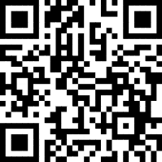
Content Library
LEGAL ONE is the leading provider of education law workshops, online courses, and webinars for school leaders and teachers on critical legal issues. New programs will be added throughout the year, so be sure to check out the LEGAL ONE Content Library for our latest legal professional learning offerings.
For a full list of all of our upcoming workshops, please visit the
Live Calendar for all of FEA (Including LEGAL ONE)
Please note that you do not have to be a member to attend our workshops. Everyone is welcome to participate and take advantage of our outstanding professional learning opportunities.

Slide 51
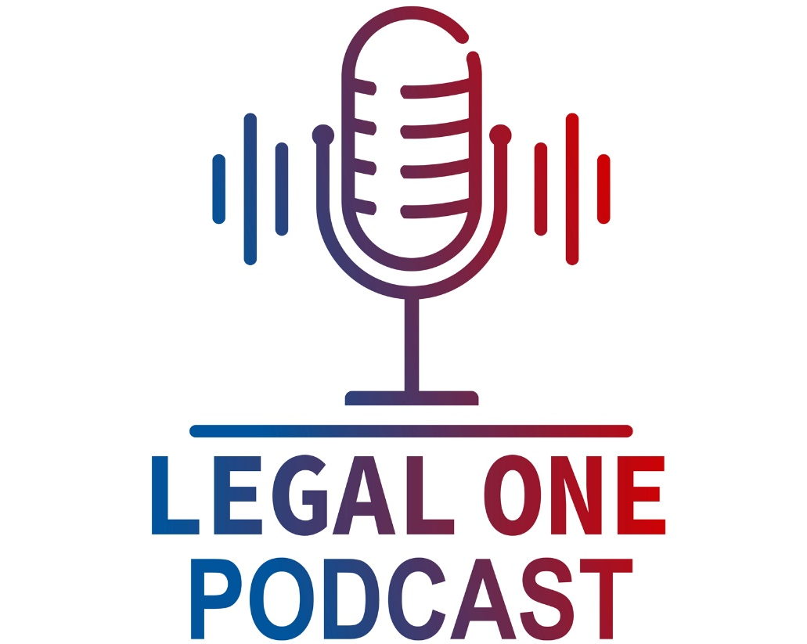



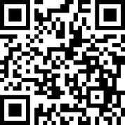
http://njpsa.org/the-legal-one-podcast/
Available in Apple Podcasts, Google Podcasts, and Spotify.
How can you understand your legal rights and responsibilities? Especially with limited time, laws that are constantly evolving, and the fact that you are always on the move? Whether you are a parent, teacher, school leader, college student or just have an interest in school law, the LEGAL ONE Podcast provides a great option for you.
As the leading provider of school law training, the LEGAL ONE team of school law experts is pleased to offer the LEGAL ONE Podcast, a weekly podcast that helps you understand complex legal issues. Each episode will be hosted by a LEGAL ONE attorney, include information on recent developments in school law and provide tips for promoting collaboration between parents and schools.

Slide 52
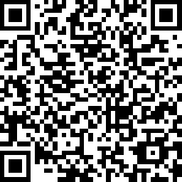
Certificate & Evaluation
Today’s professional development certificate is available to save/download at the end of a brief evaluation.
https://www.surveymonkey.com/r/LO-STSNJ-230330
Please take a few minutes to let us know what you thought of the session!

