Slide 1

Law, Ethics and Governance for All Leaders, including an Overview of New and Emerging Issues
FERPA & Mandated Reporter Issues
in School Law
June 7, 2023
Sandra L. Jacques, Esq., LL.M.
Assistant Director of Legal Education, FEA

Slide 2
DISCLAIMER
This presentation is intended as a summary of law only and is not meant as legal advice. Please consult your attorney to obtain legal advice.
Participants are authorized to use the LEGAL ONE materials provided in this training to offer turnkey training within the respective participant's school district or place of employment, provided that participants provide proper credit to LEGAL ONE for having developed said materials and further provided that such turnkey training is offered at no charge.

Slide 3
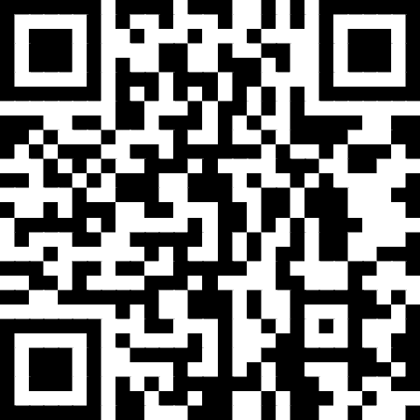
Presentation Materials
Today’s document(s) can be accessed at
https://tinyurl.com/LO-STSNJ-230607
This folder can be accessed for 30 days from the session date.
Please download all files before the link expires.

Slide 4
NJ HIB Law Overview
Duty of Care
  Certification Cases
Reporting Requirements
Overview of Student Privacy Laws
  Case Examples of FERPA Violations
  Things to Remember
  School Bus Videos

Slide 5

Duty of Care

Slide 6
Duty of Supervision
“No greater obligation is placed on school officials than to protect the children in their charge from foreseeable dangers, whether those dangers arise from the careless acts of intentional transgressions of others.”
Frugis v. Bracigliano, 177 N.J. 250 (2003)

Slide 7
Certification cases

Slide 8
Linda Mitchell v. New Jersey Department of Education, Office of Student Protection, 11/29/2021, (#298-21)
FACTS:
Petitioner was a school bus driver employed by the Mt. Laurel BOE
NJDOE suspended her School Bus Endorsement for mandatory 6 months
Allegations
  Failed to visually check her bus for students before leaving the bus unattended while dropping off paperwork at the transportation building
  Petitioner had an “affirmative duty” to visually inspect the bus / check for students
  Undisputed that she failed to check and that a child was left on the bus
    Claims she had not yet “parked the bus”
    Claims 2 staff members were standing near the bus when this occurred
    Student was quickly returned home without incident
HOLDING: SD SJM Granted
NJDOE “to notify the Motor Vehicle Commission of its obligation to suspend Petitioner’s School Bus Endorsement, and to notify Petitioner’s employer that she is ineligible for the period of suspension and continued employment as a school bus driver.”

Slide 9
Ana David-Pedi, New Jersey Department of Education, Office of Student Protection, 11/18/21, (#290-21)
FACTS:
Petitioner was a school bus driver
NJDOE suspended her School Bus Endorsement for mandatory 6 months
Allegations
  Central Jersey Prep student left on her bus at the end of one of her assigned bus routes in February 2021
    Undisputed
  Defenses
    Student was never left alone
    Claims she did a visual “turn around” inspection of the bus instead of a full visual walk-through because she had nowhere to pull over safely before continuing to her next route
    She did the required walk-through after her next stop and found the student asleep in a seat
    She then returned the child safely to Central Jersey Prep
HOLDING: SD SJM Granted
NJDOE “to notify the Motor Vehicle Commission of its obligation to suspend Petitioner’s School Bus Endorsement, and to notify Petitioner’s employer that she is ineligible for the period of suspension and continued employment as a school bus driver.”

Slide 10
Yolette Severe v. New Jersey Department of Education, Office of Student Protection, 10/31/22, (#302-22)
Facts
Petitioner was a school bus driver
A student was left on petitioner’s school bus at the end of one of her assigned bus routes on November 16, 2020.
Petitioner did not dispute that the child was left on the bus but contended that the student was never left alone.
  Although petitioner contended that she had called each student’s name as they left the bus, she conceded that she had not conducted a visual walk-through to check for remaining students, and that after petitioner arrived at the bus parking lot, a student who had fallen asleep awoke and stood up;
  Petitioner then drove the student back to their assigned school.
Holding:
“In accordance with N.J.S.A. 18A:39-29, if a school bus driver is found to have left a pupil on the bus at the end of a route, the driver’s school bus endorsement shall be suspended for six months for the first offense.”

Slide 11
Reporting requirements

Slide 12
Reporting Requirements
Staff must report whenever they suspect:
  HIB
  Dating violence
  Other forms of discrimination
  Child abuse or neglect
  Missing children
  Sexual offenses
  Situations that present a danger to adults and/or students
  Situations that create a hostile educational environment for adults and/or students
  Weapons
  Threats
  Other criminal activity

Slide 13
Staff Reporting to Outside Agencies
Child abuse or neglect:
  report to DCCP and law enforcement
Missing children:
  report to DCCP and law enforcement
Drug possession/distribution:
  report to law enforcement
Under the influence of alcohol or other drugs:
  may report to law enforcement;
  must send for medical evaluation
Firearms/other weapon possession/use:
  report to law enforcement
Sexual offenses:
  report to law enforcement and DCPP
  See Next Slide

Slide 14
NJ Mandatory Report Offenses
Sexual Offenses – school employee in the course of his/her employment has reason to believe that a crime involving sexual penetration or criminal sexual contact has been committed on school grounds, or by or against a student during school operating hours or during school-related functions or activities.

Slide 15
NJ Age of Consent and
Criminal Sexual Contact
Situations may arise between high school freshmen and seniors
Note that children under age 13 cannot consent
Students between 13 and 16 cannot consent to anyone who is more than 4 years older
No student of any age can consent to sexual relations with a school employee
Some students with disabilities are incapable of consent

Slide 16
Reporting Discrimination / Harassment
No need to confront harasser before reporting
At school, staff members should
  Report to Affirmative Action Officer (AAO)
  Report to Supervisor or Another Administrator (as per policy)

Slide 17
Role of Affirmative Action Officer
Ensure that district is in compliance with all Discrimination Laws, including requirements regarding:
  Reporting and investigation of sexual harassment complaints by students and staff
  Training of staff
  Enactment of required policies, procedures, notifications
  Coordinating Discrimination Laws compliance with other statutory requirements (bullying, dating violence, IDEIA)
Ensure that district has procedures to address all other forms of discrimination, and implements all other aspects of N.J.A.C. 6A:7
Employers have legal duty to investigate complaints of harassment/discrimination

Slide 18
HIB / Code of Conduct Reporting
Must report immediately to appropriate SD personnel
  Not for you to “just handle”
  For potential HIB’s – required by law to verbally report the same school day, and file the written report within 2 school days.
  As of July 2022, Form 338 required to be completed by the staff member
School Bus Example
  Boys at the back make lewd and explicit comments about female anatomy
  Girls at the front of the process dread riding the bus and being near these boys in school, and are obviously uncomfortable hearing the boys’ comments.

Slide 19
“Pass the Trash” Legislation
P.L. 2018, c.5 – Requires school districts, charter schools, nonpublic schools and contracted services providers working with school districts to determine if prospective employees have pending or substantiated allegations of child abuse or sexual misconduct over the past 20 years.
Signed April 11, 2018
Effective June 1, 2018

Slide 20
What is Your Chain of Command?
How would your staff answer the following questions? Do they know the correct answers?
What types of issues need to be discussed with your Supervisor?
Who do you go to when you feel that something is not right? Why?

Slide 21
Common Staff Comments / Issues
When I have a problem, I will go talk to the person that I know will take care of the situation in a way that I want the situation handled…
  This is a violation of the “Chain of Command”
  For legal reasons, there are protocols that must be followed
Look, I don’t want to deal with a bunch of nonsense and/or paperwork if there is something that I don’t like going on – I am an adult and I can just take matters into my own hands to deal with it as I see fit…
  Legally, actually you cannot – at a minimum, documentation is required
  This is also not the process that the SD wants you to follow
  Depending upon your actions, you could be disciplined/terminated.
  There may be other issues at play that you are not aware of and/or cannot know about…

Slide 22
Overview of student privacy laws

Slide 23
New Jersey Student Records Administrative Code
N.J.A.C. 6A:32-7.1 General Considerations
N.J.A.C. 6A:32-7.2 School Contact Directory for Official Use
N.J.A.C. 6A:32-7.3 Mandated student records
N.J.A.C. 6A:32-7.4 Maintenance and Security of Student Records
N.J.A.C. 6A:32-7.5 Access to Student Records
N.J.A.C. 6A:32-7.6 Conditions for Access to Student Records
N.J.A.C. 6A:32-7.7 Rights of Appeal for Parents and Adult Students
N.J.A.C. 6A:32-7.8 Retention and Disposal of Student Records

Slide 24
USDOE MARCH 2020 STUDENT PRIVACY GUIDANCE
See FERPA and Virtual Learning Related Resources, Student Privacy Policy Office, March 2020
“FERPA is the federal law that protects the privacy of personally identifiable information (PII) in students’ education records.”
“Education Records are those records that are:
  Directly related to a student; and
  Maintained by an educational agency or institution or by a party acting for the agency or institution.”

Slide 25
Parameters of Student Confidentiality
FERPA
“Personally identifiable information” includes, but is not limited to:
  Student’s name; name of student’s parent or family members
  Address of student or student’s family
  A personal identifier (e.g., SS #, student #, biometric record)
  Other indirect identifiers (e.g., dob, place of birth, mother’s maiden name)
  Other information that, alone or in combination, is linked or linkable to a particular student that would allow a reasonable person in the school community to identify the student
  Information requested by a person who the school reasonably believes knows the identity of the student to whom the education record relates
  20 U.S.C. §1232g; 34 C.F.R. §99.3

Slide 26
USDOE MARCH 2020 STUDENT PRIVACY GUIDANCE
Student Information Disclosure
  “Under FERPA, an educational agency or institution may not disclose PII from students’ education records, without consent, unless the disclosure meets an exception under FERPA. 20 U.S.C. 1232g, C.F.R. Part 99.

Slide 27
Legitimate Educational Interest
A legitimate educational reason to be aware of information pertaining to the students.
L.R. v Camden City et. al., N.J. Supreme Court Decision 7/17/19
  N.J.A.C. 6A:32-2.1 “Student record” retains protected status under NJ law even if “personally identifiable information” is redacted under FERPA
  New Jersey Pupil Records Act, N.J.S.A. 18A:36-19 and student records regulations are intended to be distinct and stricter than FERPA

Slide 28
FERPA—Permissible Release of Education Records Without Consent
In the K-12 context education records may be released without consent:
  To school officials with legitimate educational interests
    Note: A contractor, consultant, volunteer or other party to whom the school has outsourced institutional services may be considered a “school official” if the person performs an institutional function or service for which the school would otherwise use employees;
      Is under the direct control of the school with respect to use and re-disclosure of records; and
      Is subject to FERPA’s requirements governing use and re-disclosure of personally identifiable information
  To schools in which a student seeks to enroll
  In connection with a health or safety emergency
  And other purposes specified in federal regulations.
Notes:
20 U.S.C. §1232g; 34 C.F.R. §99.31.

Slide 29
Student Records in New Jersey
New Jersey Student Records Administrative Code
N.J.A.C. 6A:32-7.1 et. seq.
“Student record” means information related to an individual student gathered within or outside the school district and maintained within the school district, regardless of the physical form in which it is maintained.
Essential in this definition is the idea that any information that is maintained for the purpose of second-party review is considered a student record.
Therefore, information recorded by certified school personnel solely as a memory aid and not for the use of a second party is excluded from this definition.

Slide 30
Who Has Access to Student Records – N.J.A.C. 6A:32-7.5
Parent of student under age of 18 and student w/ written parent consent
Students, 16 or older terminating education; graduation or dropout
Student 18 or older and parent w/written student consent; parent financially dependent student
Certified school personnel w/education responsibility
Certified school personnel w/education responsibility employed by agencies, schools
Board of education, CSA, closed session unless otherwise requested by parent or adult student

Slide 31
Who Has Access to Student Records – N.J.A.C. 6A:32-7.5
Secretarial and clerical personnel
Accrediting organizations, Commissioner and DOE staff
Other boards of education where student is placed, registered or seeks to enroll
USDOE officials, DCP&P, state and local welfare agencies
Consent from parent/guardian, Court order, bona-fide researcher
In complying with this section, individuals shall adhere to requirements pursuant to the Open Public Records Act (OPRA) and the Family Educational Rights and Privacy Act (FERPA).

Slide 32
Selected Student Records and Confidentiality Issues
Divorced and Separated Parents
The Non-Custodial Parent has the same rights as the custodial parent, unless rights have been terminated pursuant to a court order. Get and review a copy of the settlement agreement, if there is one.
Note that a Court Order is signed by a judge
  Different from a subpoena which can be signed by an attorney

Slide 33
General Considerations – N.J.A.C. 6A:32-7.1
Student health records shall be maintained separately from other student records. Upon graduation or termination, the health history and immunization record shall be removed from the student’s health record and placed in the student’s mandated record.

Slide 34
Case examples of violations of ferpa

Slide 35
Miguel v. Mahwah BOE
11/16/18 - #373-18
Facts:
SD filed CU Charges against tenured English Teacher / SGA Advisor for multiple alleged acts, including a FERPA violation:
  Took pictures of students in school without their consent
  Inserted captions on the picture
  Texted the image to other students in the SGA Group Chat
  Teacher admitted taking and posting the pictures, but claimed that the act was not meant to be mean-spirited.

Slide 36
Miguel v. Mahwah BOE
11/16/18 - #373-18
Analysis:
“At the hearing, the [teacher] admitted that he knew pupil confidentiality laws prohibit school officials from taking photos of students without parental consent, and that he had violated the law.”
  Teacher violated FERPA
  “Taking pictures of students without their knowledge or consent is inappropriate and unprofessional in a school environment.”
  “The [teacher’s] claim that he was making a joke, and did not realize he upset anyone, is of no import. Demeaning students is not appropriate conduct for a teacher.”
  “The [teacher] showed a lack of sensitivity for students’ feelings and a lack of understanding of societal norms and boundaries, especially for a professional educator who interacts with minors.”
Holding: Sustained. Teacher is dismissed.

Slide 37
Rene Chakmakian v. Englewood Cliffs SD, 2/19/2020
Facts: SD filed Conduct Unbecoming Charges against tenured 18 year Special Education teacher.
SD Allegations:
Claimed she violated FERPA and NJ Pupils Records Statutes
While investigating the server usage of another teacher (her fiancé), the SD discovered inappropriate email exchanges between the two staff members

Slide 38
Rene Chakmakian v. Englewood Cliffs SD, 2/19/2020
Alleged Email Content
  Behavior Chart of a student;
  Copy of an email to a parent re: child’s disruptive behavior; discussion about a challenging student using vulgar and derogatory language and a recommendation that if the student acted up, they should be removed from the fiancé's class;
  Referring to a group of mothers of students in a pejorative manner;
  References to the Principal in an offensive and vulgar manner;
  Copy of an email to a parent regarding strategies for tutoring a student,
  Copy of an email re: available tutoring times of a student;
  Disparaged her supervisor – “I can’t wait til serve her head on a platter.”;
  Disparaged another teacher and the teacher’s children/SD students;
  Copy of Group email about a classified student’s unpacking routine;
  Copy of a reply to a parent with a grade question – disparaging the parent – “hate this place and kids and parents --- like my --- will never get additional help;
  Mocking and disparaging another staff member’s ability to conduct a training and
  Described 2 teachers with unflattering nick-names as “being two-faced in their treatment of another staff member.”

Slide 39
Rene Chakmakian v. Englewood Cliffs SD, 2/19/2020
Rationale:
Teacher violated SD policies:
  “Using private email to send information to her fiancé w/o parental permission to do so;
  Using SD’s email account for private emailing;
  Using inappropriate and unprofessional language on emails sent from her SD account; and
  Making demeaning and at times vile statements in her emails about her Administrators, coworkers and students.”
SD did not prove willful violation and that she cannot be rehabilitated.
Emails with student information that were sent from/to private email accounts were not in compliance with SD requirements of confidentiality

Slide 40
Rene Chakmakian v. Englewood Cliffs SD, 2/19/2020
Holding: Sustained in part and Dismissed in part.
Reinstate to her former position
Reduce Termination to Suspension from date of suspension to this Award date, to include the period of suspension already served w/o pay of no more than 120 days
Withhold 2019-2020 Increment
Provide adequate support and time to successfully complete her Professional Improvement Plan

Slide 41
Sarmiento v. SD Twp of Saddle Brook
8/31/17
FACTS:
Teacher/Coach accused of improperly communicating with students via text and improperly using her phone during class time
Teacher/Coach accused of getting rid of her cell phone when she knew tenure charges were going to be brought against her for improper use of the phone in violation of SD policies
HOLDING / Discipline:
Spoliation imposed against teacher
  In essence, since the teacher “got rid of the phone” when she knew tenure charges were pending, the Court assumed that the SD’s allegations pertaining to the improper phone use were true
Conduct Unbecoming Found
Penalty was 120 Day Suspension

Slide 42
Things to Remember
Because of your job, you know a lot about people including “personally identifiable information” such as:
  Names
  Parent / Family Member Identities
  Family History
  Addresses
    Both home and facility locations
  Personal Identifier ID’s
    Social Security Number
    Facility ID Number
  Physical Appearance
  Crimes Committed and any Affiliated Information
  Medical Conditions / Disabilities
  Any information that, alone or in combination, is linked or linkable to a particular person that would allow a reasonable person in the community to identify that individual

Slide 43
Things to Remember
For those that live in the town where they work – staff members CANNOT be the “eyes and ears” for their friends, relatives and neighbors, or give them a “heads up” when something involving their child has occurred.
There are cameras on the busses – everything that you do, or don’t do, is recorded and subject to review

Slide 44
Bus Videos
The SD has the right to see the School Bus Videos
  Private companies can not “pre-screen” videos prior to turning them over to the SD
  The SD is bound by privacy laws pertaining to both students and staff, and will only share the “educationally relevant” material with those that need to know…

Slide 45
Things to Remember
You do not have the right to use students’, colleagues’, subordinates’ personal information / photos / audio for your personal amusement / venting session / workplace complaints
  Violations could subject you to Civil Rights Claims
  Violations could result in disciplinary measures being taken against you
Federal / State law, and SD policies require that you protect the privacy rights of these individuals
  Things that are allowed to be made public about these individuals will be done so in the proper forum(s) by the appropriate staff member(s) in compliance with the law.

Slide 46
Conclusion
Thank you for choosing professional development with LEGAL ONE!
Visit our website for more courses that can support your work at http://www.njpsa.org/legalonenj/
Participants are authorized to use the LEGAL ONE materials provided in this training to offer turnkey training within the respective participant's school district or place of employment, provided that participants provide proper credit to LEGAL ONE for having developed said materials and further provided that such turnkey training is offered at no charge.
If you have any questions about this presentation or suggestions for future seminars, please send an email to legalone@njpsa.org or sjacques@njpsa.org

Slide 47


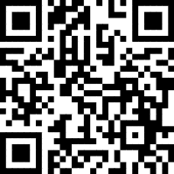
Content Library
LEGAL ONE is the leading provider of education law workshops, online courses, and webinars for school leaders, educators, and other key stakeholders. New programs will be added throughout the year, so be sure to check out the LEGAL ONE Content Library for our latest legal professional learning offerings.
For a full list of all of our upcoming workshops, please visit the
Live Calendar for all of FEA (Including LEGAL ONE)
Please note that you do not have to be a member to attend our workshops. Everyone is welcome to participate and take advantage of our outstanding professional learning opportunities.

Slide 48
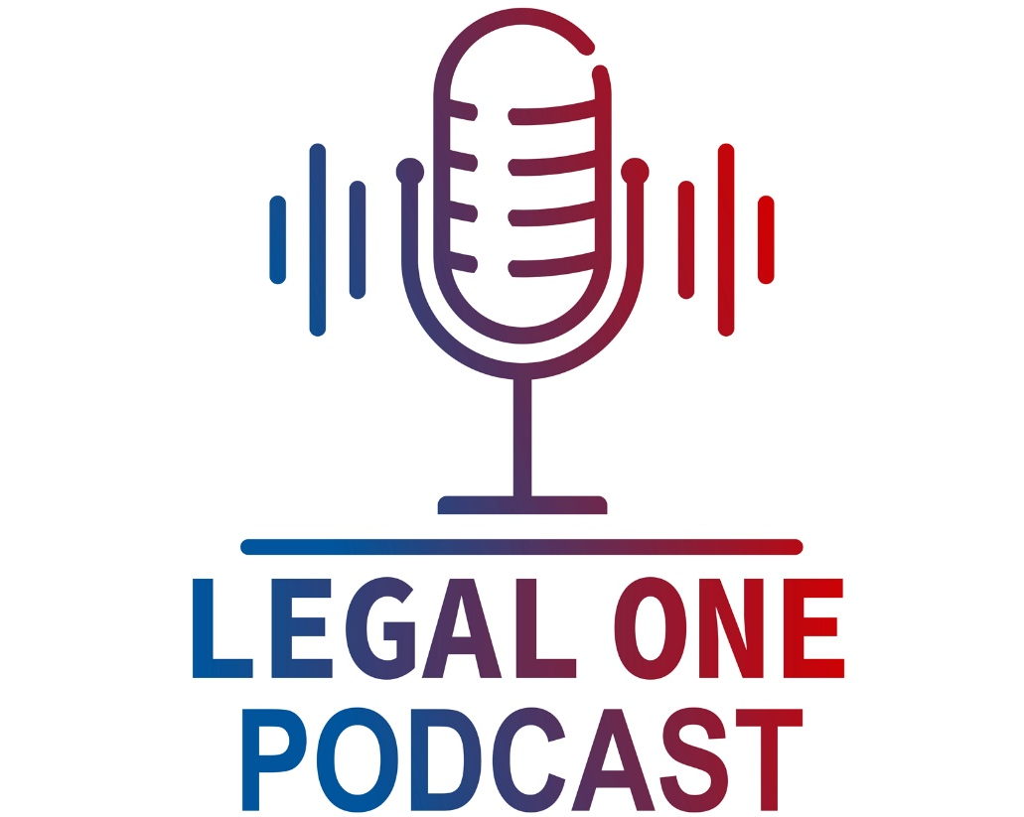



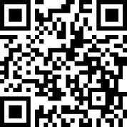
http://njpsa.org/the-legal-one-podcast/
Available in Apple Podcasts, Google Podcasts, and Spotify.
How can you understand your legal rights and responsibilities? Especially with limited time, laws that are constantly evolving, and the fact that you are always on the move? Whether you are a parent, teacher, school leader, college student or just have an interest in school law, the LEGAL ONE Podcast provides a great option for you.
As the leading provider of school law training, the LEGAL ONE team of school law experts is pleased to offer the LEGAL ONE Podcast, a weekly podcast that helps you understand complex legal issues. Each episode will be hosted by a LEGAL ONE attorney, include information on recent developments in school law and provide tips for promoting collaboration between parents and schools.

Slide 49

Click here for a flipbook catalog of Summer 2023 offerings.
Hyperlinks in the flipbook calendar will take you directly to registration pages.
www.njpsa.org
Click here for a printable pdf of the Summer 2023 catalog.

Slide 50
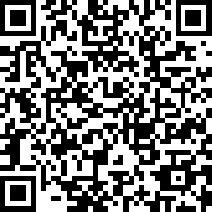
Certificate & Evaluation
Today’s professional development certificate is available to save/download at the end of a brief evaluation.
https://www.surveymonkey.com/r/LO-STSNJ-230607
Please take a few minutes to let us know what you thought of the session!

